Slide 1
Technological ONION
Computer Systems – Hardware
Sources: Patricia Setser
Modified: Margaret Lion

Slide 2
Relationship of OS to hardware and software ONION ANALOGY
Notes:
The OS is the go-between for the hardware and the programs and data: it is the grunt soldier. When a program (the Army’s general officer) issues a command to write to or read from a device, the OS does its soldierly duty and implements the instruction. The OS forms a common interface for all programs for the specifics of loading a program to memory, writing to a disk, moving the read/write disk head, spinning the disk platter, and so on. Some of the most popular operating systems currently in use include Windows, Windows NT, and UNIX. Visual Basic is a development tool which writes programs for Windows-based operating systems.

Slide 3
Computer Hardware
Hardware is the computer and any equipment connected to it
Hardware devices are the physical components of the computer
Items such as the monitor, keyboard, mouse, and printer are also known as peripherals because they attach to the computer
Something you can touch.

Slide 4
Computer Hardware - Functions
Information processing cycle of a computer
Input – Computer gathers data or allows a user to add data
Processing – Data is converted into information
Output – Data or information is retrieved from the computer
Storage – Data or information is stored for future use

Slide 5
Types of Computers
Supercomputers –
Large, powerful computers devoted to specialized tasks
Fastest and most expensive of all computers
Perform sophisticated mathematical calculations, track weather patterns, monitor satellites, and perform other complex, dedicated tasks
Cost: $1M - $30M +
Purpose: Numerically intensive scientific applications, research

Slide 6
Types of Computers
Mainframe computers –
Large computers often found in businesses and colleges, where thousands of people use the computer to process data
They Multitask, as they can perform more than one task at the same time
This capability is one of the primary ways mainframes differ from supercomputers
Cost: $500K - $10M +
Purpose: Large businesses

Slide 7
Types of Computers
Microcomputers –
Are the smallest of the categories of computers and the one that most people typically use
Range in size from servers that have a storage capability of minicomputers (and small mainframes) to handheld devices that fit in your pocket
Cost: $400 - $5K
Purpose: Personal, Put on LANs, Small Business

Slide 8
Types of Microcomputers
Microcomputers – smallest type of computers
Desktop computers sit on your desktop, floor, table, or other flat surface and have a detachable keyboard, mouse, monitor and other pieces of equipment
Notebook computers, also called laptops, which are mobile
Tablet computers, similar to notebooks but screen can be written on with a special pen called a stylus
Smartphones offer more computer capabilities then the PDA.
Notes:
Describe the three types of microcomputers. A desktop computer is the largest of the three, and usually remains on a desk, table, or other surface. You would use this type of computer if you didn’t need to take a computer to different locations.

Slide 9
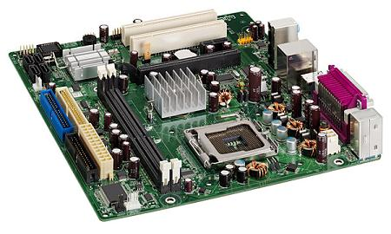
Components - System Unit
System Unit
If you remove the cover from the system unit, you find several key components inside

Slide 10
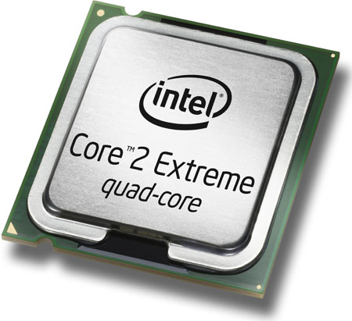
Components - System Unit
One of the most essential components is the microprocessor chip, also known as the central processing unit (CPU)
The CPU is located on the motherboard, a large printed circuit board to which all the other circuit boards in the computer are connected

Slide 11
Components - Central Processing Unit
System Unit
The CPU is the brain of the computer and is responsible for controlling all the commands and tasks the computer performs
Two main parts – the control unit and the arithmetic logic unit (ALU)
The control unit is responsible for obtaining instructions from the computer’s memory, and then interprets and executes them
Notes:
Even though the CPU is very powerful, it is relatively small. Explain the two parts of the CPU (Control Unit and Arithmetic/Logic unit). CPUs are measured by their processing speed, known as clock speed. Processing speed is measured in megahertz (MHz) and has increased dramatically over the years.

Slide 12
Basic Computer Hardware - Functions
Notes:
The input/output (I/O) units consist of an input unit and an output unit. The input unit feeds a program and the initial data into the memory, and the output unit provides results in a form that can be either read by users or further processed by other computers. The input unit includes typewriter-like keyboards, optical scanners, and other equipment. The output unit includes printers, cathode-ray tube (CRT) and liquid-crystal display (LCD) monitors, and sound generators.

Slide 13
Components - Central Processing Unit --- MOTHERBOARD
Motherboard/system board
Main computer circuit board; connects all components

Slide 14
Hardware Devices and Their Uses
Memory is another critical computer component found within the system unit - Two types of memory: ROM and RAM
RAM - Temporary holding area where data is stored – RAM means Random Access Memory
RAM acts as the computer’s short-term memory and stores data temporarily as it is being processed
RAM is considered to be volatile because this memory is erased when the computer is turned off
ROM, or Read Only Memory, is prerecorded on a chip
Information on a ROM chip can’t be changed, removed, or rewritten
Nonvolatile memory -- it retains its contents even if the computer is turned off
ROM is used to store critical information such as the program used to start up, or boot, the computer
Notes:
Make sure students understand computer memory and that there are two types. It is especially important to realize that RAM is temporary storage, so any data not saved to disk is lost if you turn off the computer.

Slide 15
Components - Data Storage
Storage Devices – Memory Types
Store data and information used by or created with the computer
This storage is permanent memory, because data saved to a storage device remains there until the user deletes or overwrites it
Volatile memory is any memory that would be lost once the computer was shut off.

Slide 16
Components - Data Storage
Storage Devices
Flash memory is a popular form of storage
Used in PDAs, digital cameras, and MP3 players
It is a mechanical drive
Hard disk drive – A hard disk drive is the computer’s largest internal storage device - Usually measured in gigabytes (GB)

Slide 17
Components - Data Storage
Storage for data is given in bytes
1 Kilobyte (KB) = 1,024 bytes
1 Megabyte (MB) = 1,048,576 bytes or1,024 KB
1 Gigabyte (GB)= Little over 1 billion bytes or 1,024 MB
1 Terabyte (TB) = 1,024 GB
Source: http://www.kb.iu.edu/data/ackw.html
page 12

Slide 18
Components - Input Devices
The two most common:
Keyboard – Contains groups of keys used in different ways to input data: for example, the typing keypad is used to enter text and other data. The numeric keypad is used to enter numbers and perform calculations.
Mouse – Small hand-sized unit that acts as a pointing device.
Notes:
If students are even remotely familiar with a computer, they are familiar with these two input devices. Additional input devices, such as a graphics table, touch screen, point-of-sale system, and joy stick, are also mentioned in the text.

Slide 19
Components - Output Devices
Hardware used to get data and information from the computer into an understandable format.
Monitors (aka computer screens) – Display data, text, and graphics.
Printers – Produce paper printouts of data and information. Also can be input devices if they include scanning, faxing, and copying capabilities.

Slide 20
Further Study
For more information visit the Microsoft site Windows 10 help.

